Slide 1
Generative models

Slide 2
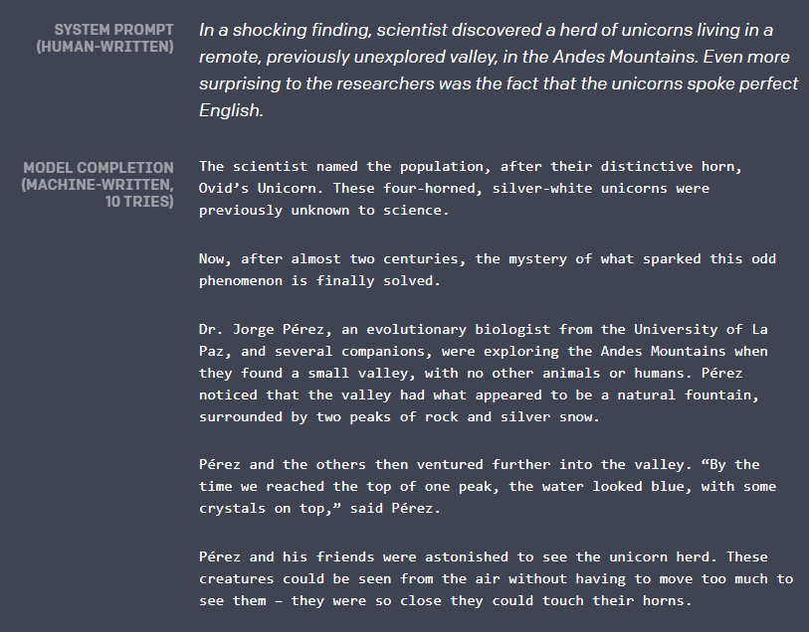
GPT-2: SOTA for machine text generation
https://blog.openai.com/better-language-models/#content

Slide 3
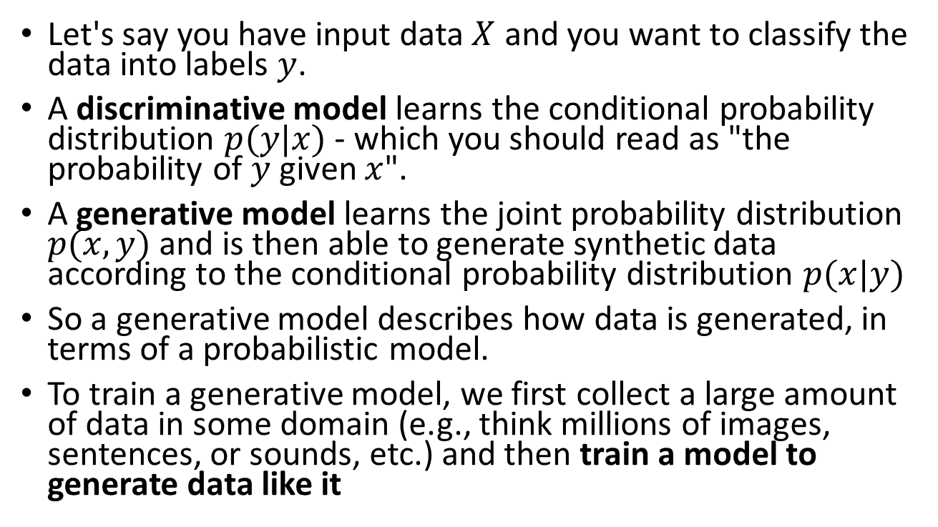
What are generative models?
Let's say you have input data $X$ and you want to classify the data into labels $y$.
A discriminative model learns the conditional probability distribution $p(y|x)$ - which you should read as "the probability of $y$ given $x$".
A generative model learns the joint probability distribution $p(x,y)$ and is then able to generate synthetic data according to the conditional probability distribution $p(x|y)$
So a generative model describes how data is generated, in terms of a probabilistic model.
To train a generative model, we first collect a large amount of data in some domain (e.g., think millions of images, sentences, or sounds, etc.) and then train a model to generate data like it

Slide 4
Approaches to generative models
Variational Autoencoders (VAEs) allow us to formalize this problem in the framework of probabilistic graphical models where we are maximizing a lower bound on the log likelihood of the data.
Generative Adversarial Networks (GANs), pose the training process as a game between two separate artificial neural networks: a generator network and a second discriminative network that tries to classify samples as either coming from the true distribution or the model distribution. Every time the discriminator notices a difference between the two distributions the generator adjusts its parameters slightly to make it go away, until at the end (in theory) the generator exactly reproduces the true data distribution and the discriminator is guessing at random, unable to find a difference.

Slide 5
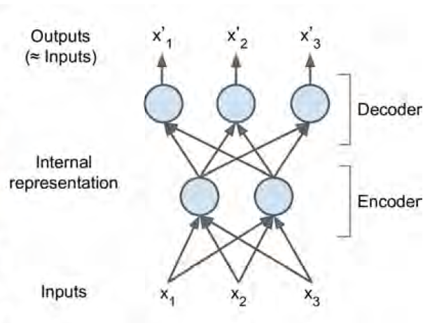
A word on Autoencoders
Autoencoders are artificial neural networks capable of learning efficient vector representations of the input data, called codings, without any supervision (i.e., the training set is unlabeled).
Word embeddings using word2vec are a type of autoencoder
These codings typically have a much lower dimensionality than the input data, making autoencoders useful for dimensionality reduction.
More importantly, autoencoders act as powerful feature detectors, and they can be used for unsupervised pretraining of deep neural networks
Lastly, they are capable of randomly generating new data that looks very similar to the training data; this is called a generative model.
For example, you could train an autoencoder on pictures of faces, and it would then be able to generate new faces.

Slide 6
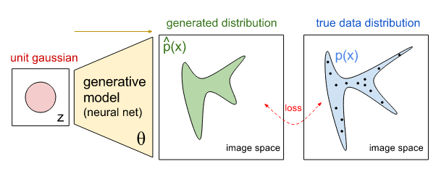
Learning the data manifold
Surprisingly, autoencoders work by simply learning to copy their inputs to their outputs.
This may sound like a trivial task, but we will see that constraining the network in various ways can make it rather difficult.
For example, you can limit the size of the internal representation, or you can add noise to the inputs and train the network to recover the original inputs.
These constraints prevent the autoencoder from trivially copying the inputs directly to the outputs, which forces it to learn efficient ways of representing the data.
In short, the codings are byproducts of the autoencoder’s attempt to learn the identity function under some constraints.
The trick is that the neural networks we use as generative models have a number of parameters significantly smaller than the amount of data we train them on, so the models are forced to discover and efficiently internalize the essence of the data in order to generate it.

Slide 7
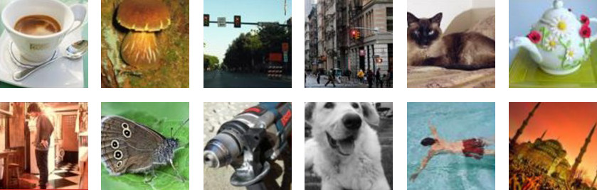
Generating images
Suppose we have some large collection of images, such as the 1.2 million images in the ImageNet dataset
These images are examples of what our visual world looks like and we refer to these as “samples from the true data distribution”.
We now construct our generative model which we would like to train to generate images like this from scratch.
Concretely, a generative model in this case could be one large neural network that outputs images and we refer to these as “samples from the model”.

Slide 8
Training a generative model
Suppose that we used a newly-initialized network to generate 200 images, each time starting with a different random code.
The question is: how should we adjust the network’s parameters to encourage it to produce slightly more believable samples in the future?
Notice that we’re not in a simple supervised setting and don’t have any explicit desired targets for our 200 generated images; we merely want them to look real.

Slide 9
Sampling from latent spaces of images
The key idea of image generation is to develop a low-dimensional latent space of representations (which naturally is a vector space) where any point can be mapped to a realistic-looking image.
The module capable of realizing this mapping, taking as input a latent point and outputting an image (a grid of pixels), is called a generator (in the case of GANs) or a decoder (in the case of VAEs).
Once such a latent space has been developed, you can sample points from it, either deliberately or at random, and, by mapping them to image space, generate images that have never been seen before
Notes:
GANs and VAEs are two different strategies for learning such latent spaces of image
representations, each with its own characteristics. VAEs are great for learning latent
spaces that are well structured, where specific directions encode a meaningful axis of
variation in the data. GANs generate images that can potentially be highly realistic, but
the latent space they come from may not have as much structure and continuity.

Slide 10
Generating faces of humans that do not exist
https://www.thispersondoesnotexist.com

Slide 11
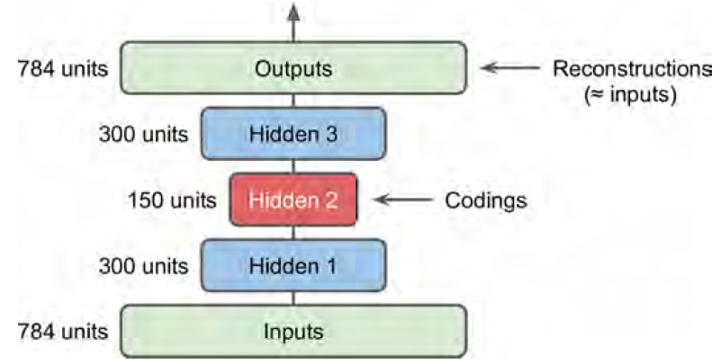
Encoder and decoder network
A type of network that aims to encode an input to a low-dimensional latent space and then decode it back
A classical image autoencoder takes an image, maps it to a latent vector space via an encoder module (a convolutional neural network for instance), and then decodes it back to an output with the same dimensions as the original image, via a decoder module
It’s then trained by using as target data the same images as the input images, meaning the autoencoder learns to reconstruct the original inputs.
Most commonly, you’ll constrain the code to be low-dimensional and sparse (mostly zeros), in which case the encoder acts as a way to compress the input data into fewer bits of information.

Slide 12
Variational autoencoders
In practice, such classical autoencoders don’t lead to particularly useful or nicely structured latent spaces.
VAEs, however, augment autoencoders with a little bit of statistical magic that forces them to learn continuous, highly structured latent spaces.
They have turned out to be a powerful tool for image generation.
A VAE, instead of compressing its input image into a fixed code in the latent space, turns the image into the parameters of a statistical distribution: a mean and a variance.
Essentially, this means you’re assuming the input image has been generated by a statistical process, and that the randomness of this process should be taken into accounting during encoding and decoding.
The VAE then uses the mean and variance parameters to randomly sample one element of the distribution, and decodes that element back to the original input.
The stochasticity of this process improves robustness and forces the latent space to encode meaningful representations everywhere: every point sampled in the latent space is decoded to a valid output.

Slide 13
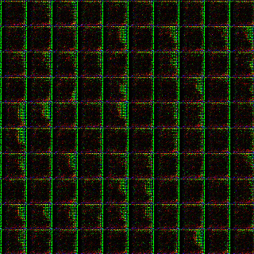
What these networks learn
These neural networks are learning what the visual world looks like!
These models usually have only about 100 million parameters, so a network trained on ImageNet has to (loosely) compress 200GB of pixel data into 100MB of weights.
This incentivizes it to discover the most salient features of the data
It will likely learn that pixels nearby are likely to have the same color, or that the world is made up of horizontal or vertical edges, or blobs of different colors.
Eventually, the model may discover many more complex regularities: that there are certain types of backgrounds, objects, textures, that they occur in certain likely arrangements, or that they transform in certain ways over time in videos, etc.

Slide 14
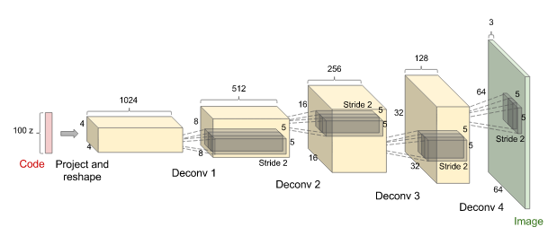
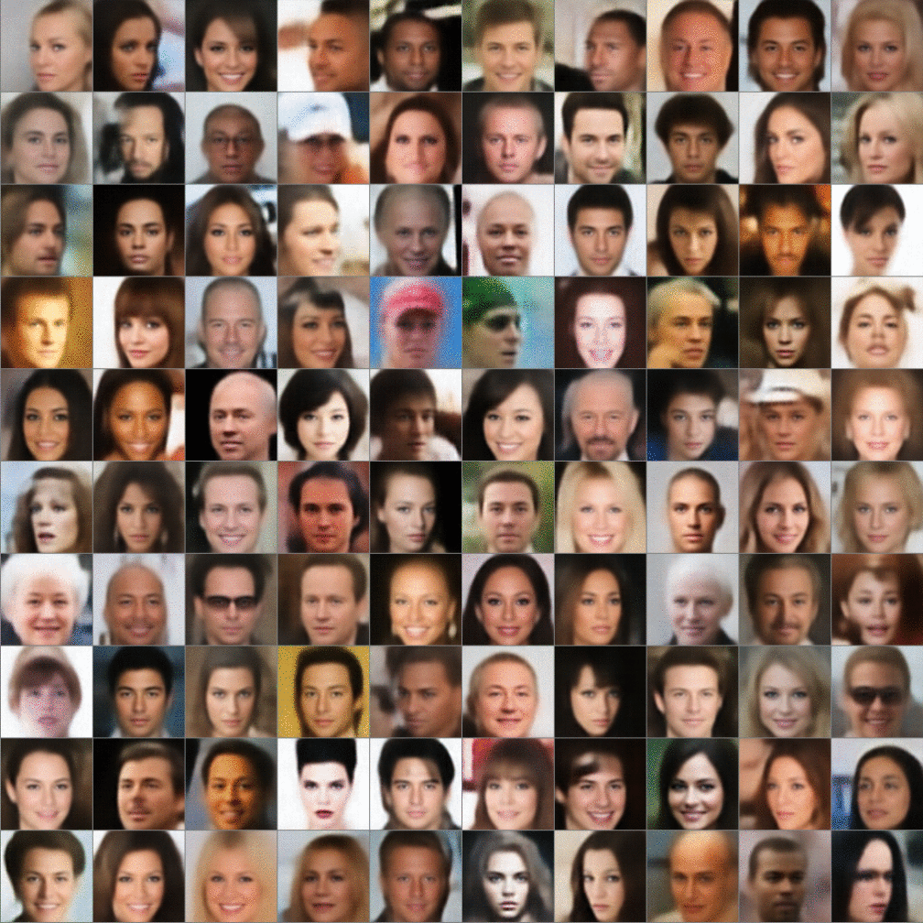
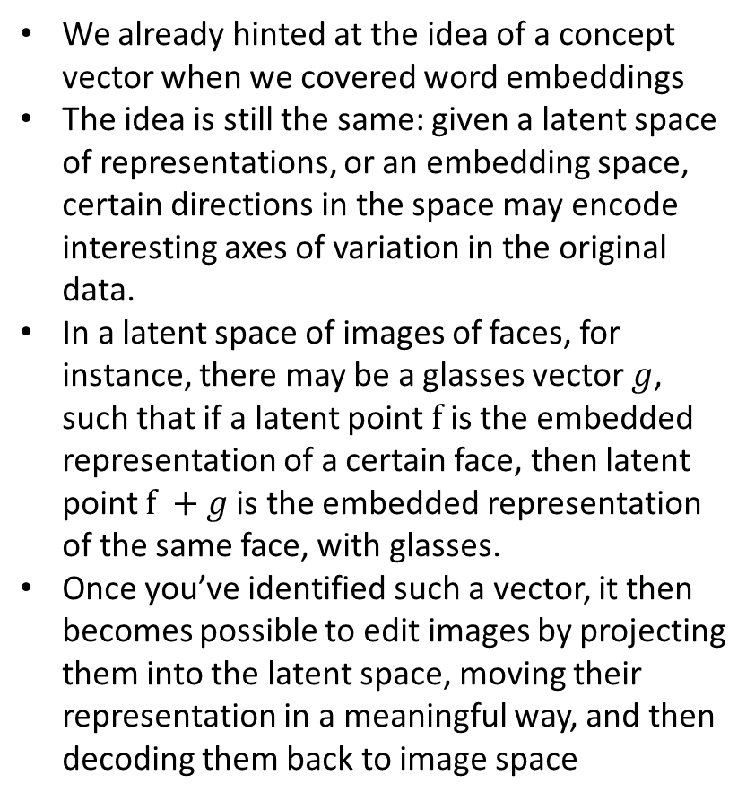
Concept vectors and the glasses dimension
We already hinted at the idea of a concept vector when we covered word embeddings
The idea is still the same: given a latent space of representations, or an embedding space, certain directions in the space may encode interesting axes of variation in the original data.
In a latent space of images of faces, for instance, there may be a glasses vector $g$, such that if a latent point $f$ is the embedded representation of a certain face, then latent point $f +g$is the embedded representation of the same face, with glasses.
Once you’ve identified such a vector, it then becomes possible to edit images by projecting them into the latent space, moving their representation in a meaningful way, and then decoding them back to image space

Slide 15
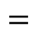
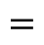
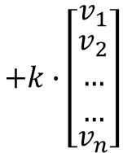
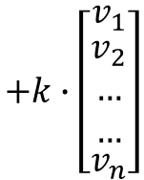
The smile vector
Increase weight of k
$${image}_{output}={image}_{input}+{k∙vector}_{smile}$$
$$+k∙\left[\begin{matrix}v_{1} \\ \begin{matrix}v_{2} \\ … \\ …\end{matrix} \\ v_{n}\end{matrix}\right]$$
$$=$$
$${image}_{output}={image}_{input}−{k∙vector}_{smile}$$
$$+k∙\left[\begin{matrix}v_{1} \\ \begin{matrix}v_{2} \\ … \\ …\end{matrix} \\ v_{n}\end{matrix}\right]$$
$$=$$

Slide 16
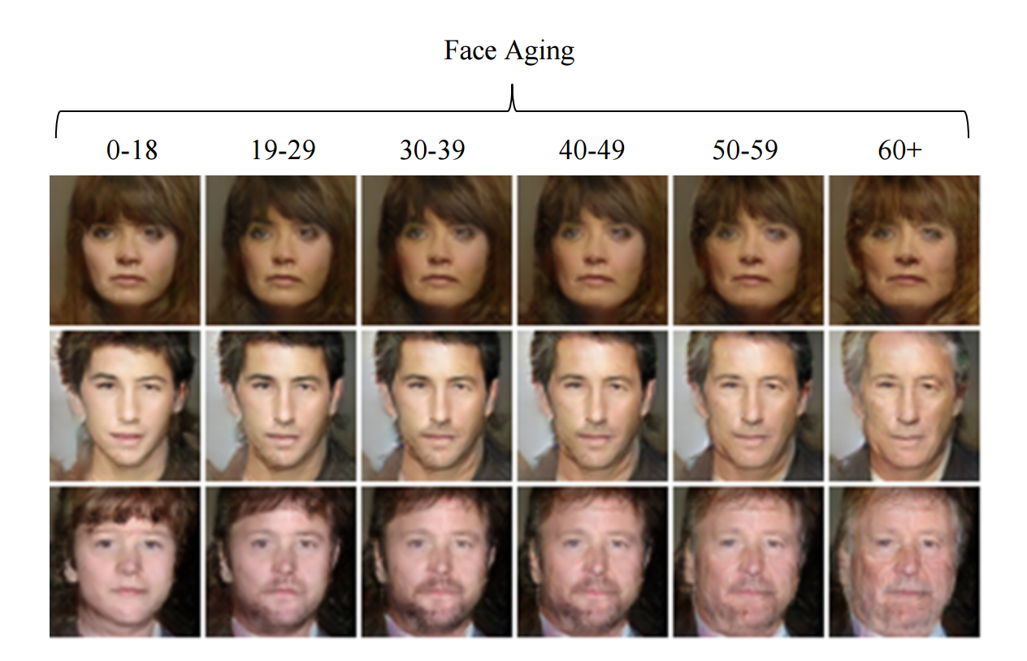
The age vector

Slide 17
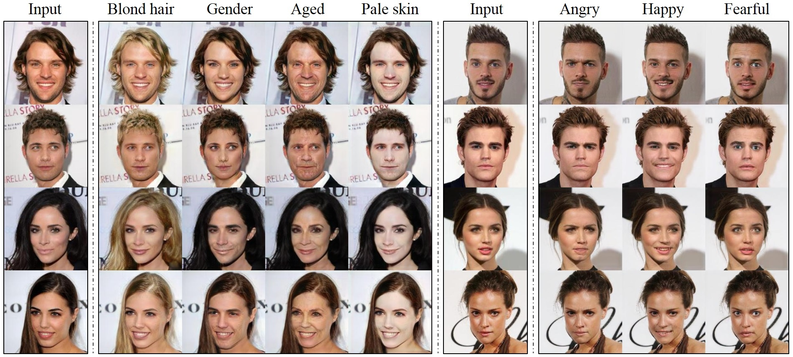
Other dimensions in the learned latent space

Slide 18
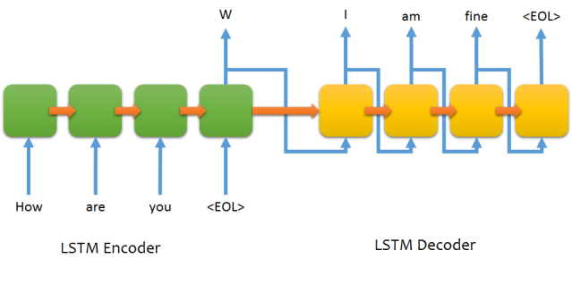
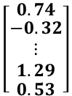
LSTMs as generative models
You can build and train sequence-to-sequence neural network using LSTMs
Such models are useful for machine translation, chatbots, parsers, music generation…
$$\left[\begin{matrix}0.74 \\ \begin{matrix}−0.32 \\ ⋮ \\ 1.29\end{matrix} \\ 0.53\end{matrix}\right]$$

Slide 19
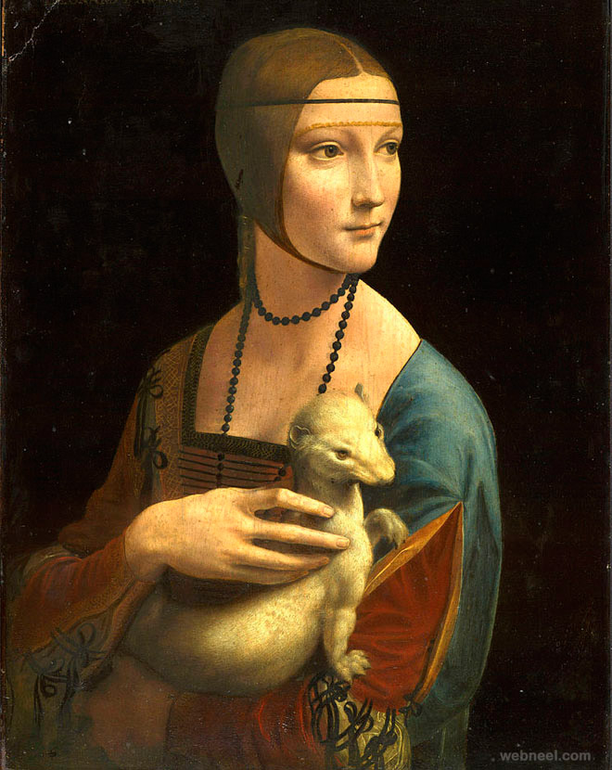
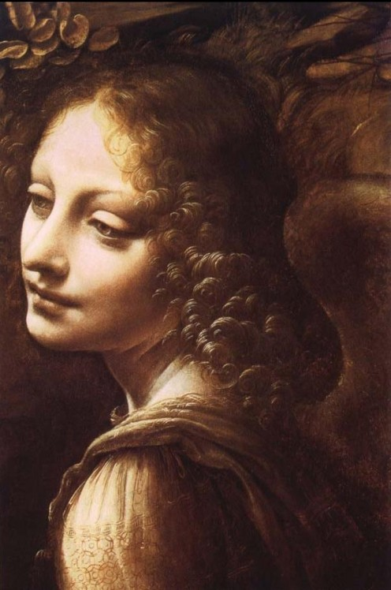
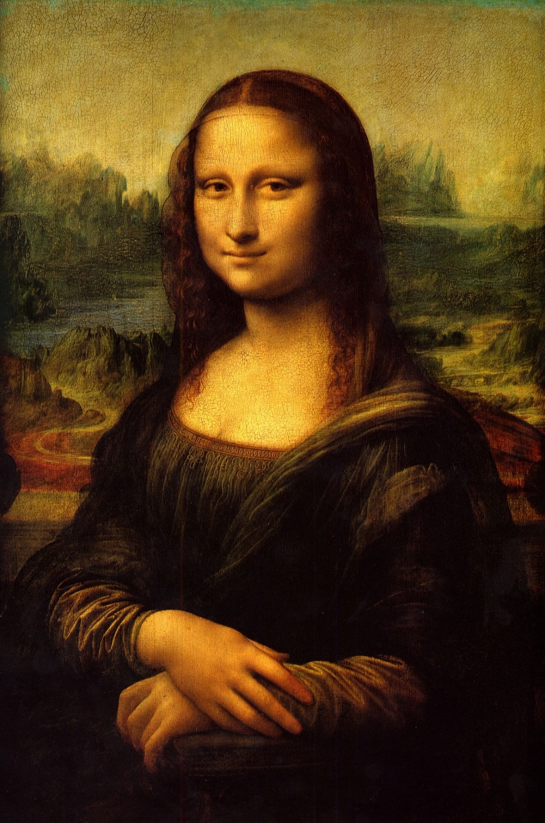
Generative adversarial network (GAN)
An alternative to VAEs are GANs
An intuitive way to understand GANs is to imagine a forger trying to create a fake Leonardo da Vinci painting.
At first, the forger is pretty bad at the task.
He mixes some of his fakes with authentic Leonardo da Vinci paintings and shows them all to an art dealer.
The art dealer makes an authenticity assessment for each painting and gives the forger feedback about what makes a Leonardo da Vinci painting look like one.
The forger goes back to his studio to prepare some new fakes.
As times goes on, the forger becomes increasingly competent at imitating the style of Leonardo da Vinci, and the art dealer becomes increasingly expert at spotting fakes.
In the end, they have on their hands some excellent fake Leonardo da Vinci paintings.

Slide 20
Generative adversarial network (GAN)
A GAN is made of two parts:
Generator network—Takes as input a random vector (a random point in the latent space), and decodes it into a synthetic image
Discriminator network (or adversary)—Takes as input an image (real or synthetic), and predicts whether the image came from the training set or was created by the generator network.
The generator network is trained to be able to fool the discriminator network, and thus it evolves toward generating increasingly realistic images as training goes on: artificial images that look indistinguishable from real ones, to the extent that it’s impossible for the discriminator network to tell the two apart
Meanwhile, the discriminator is constantly adapting to the gradually improving capabilities of the generator, setting a high bar of realism for the generated images.
Once training is over, the generator is capable of turning any point in its input space into a believable image.
Notes:
Unlike VAEs, this latent space has fewer explicit guarantees of meaningful
structure; in particular, it isn’t continuous.

Slide 21
Generator network
This network takes as input 100 random numbers drawn from a uniform distribution (we refer to these as a code, or latent variables, in red) and outputs an image (in this case 64x64x3 images on the right, in green).
As the code is changed incrementally, the generated images do too — this shows the model has learned features to describe how the world looks, rather than just memorizing some examples
The network (in yellow) is made up of standard convolutional neural network components, such as deconvolutional layers (reverse of convolutional layers), fully connected layers, etc
DCGAN is initialized with random weights, so a random code plugged into the network would generate a completely random image.
However, as you might imagine, the network has millions of parameters that we can tweak, and the goal is to find a setting of these parameters that makes samples generated from random codes look like the training data.

Slide 22
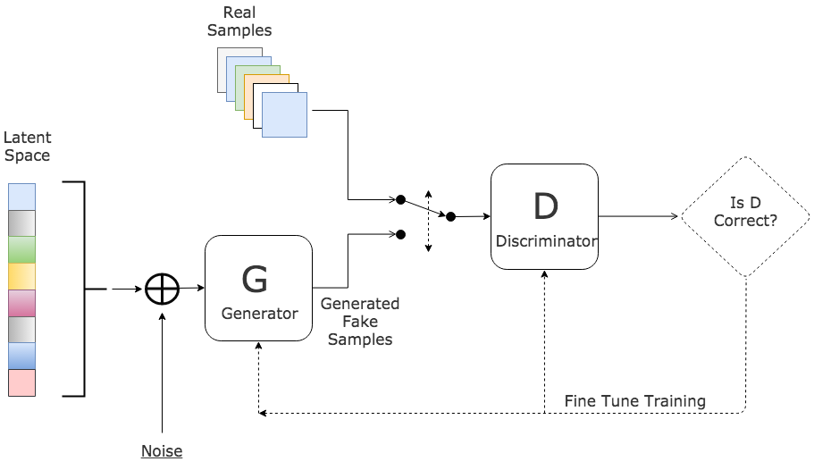
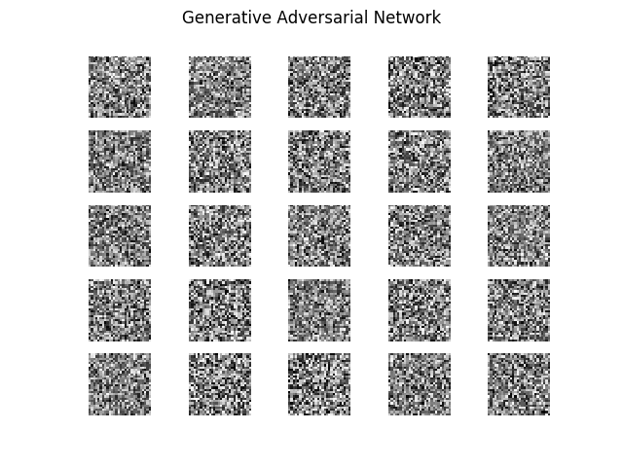
Discriminator Network
Here we introduce a discriminator network (usually a standard convolutional neural network) that tries to classify if an input image is real or synthetically generated.
For instance, we could feed the 200 generated images and 200 real images into the discriminator and train it as a standard classifier to distinguish between the two sources.
But in addition to that — and here’s the trick — we can also backpropagate through both the discriminator and the generator to find how we should change the generator’s parameters to make its 200 samples slightly more confusing for the discriminator.
These two networks are therefore locked in a battle: the discriminator is trying to distinguish real images from fake images and the generator is trying to create images that make the discriminator think they are real.
In the end, the generator network is outputting images that are indistinguishable from real images for the discriminator.
Images produced by the generator

Slide 23
Adversarial examples
Artificial intelligence research has significant theoretical holes. Most advances are heuristic (i.e. empirical)
Often, we don’t really know why things work or don’t
A good example is how GANs can be used to foul computer vision systems
The idea is to use imperceptible changes to data can alter a deep learning model’s prediction
Adversarial examples cause computer vision models to make glaring mistakes!
An unnoticeable universal noise filter applied to an image of a panda makes the model think it sees a gibbon
This has important implications for computer security

Slide 24
Adversarial examples
A method for creating universal, robust, targeted adversarial image patches in the real world
The “toaster” patch maximally excites the computer vision model so that it always sees a toaster even when there is no “real” toaster in view.

Slide 25
Adversarial attacks present serious security challenges in the real world
A vision system that previously detected pedestrians at a zebra crossing is no longer able to “see” them.
This poses obvious security concerns when autonomous vehicles make it onto public roads.

Slide 26
Additional interesting applications of generative models

Slide 27

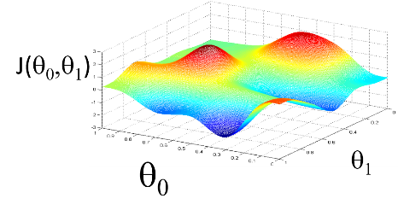
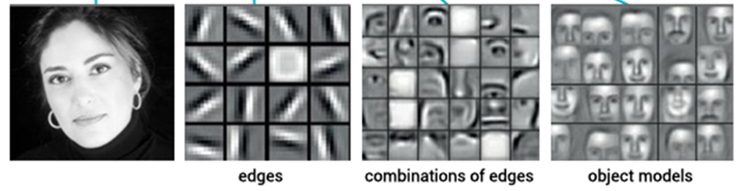
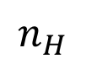
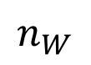
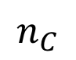
Neural style transfer
Content target
Output
combination image
Style reference
Define style as the correlation between activations across channels
$$n_{H}$$
$$n_{C}$$
$$n_{W}$$
loss = distance(style(reference_image) - style(generated_image)) + distance(content(original_image) - content(generated_image))
Notes:
Style refers to levels of detail at different scales in the painting
Content refers to high level structure of the image
This sort of technique has a lot of implications for creating artistic work

Slide 28
Inducing psychedelic dreams in the network

Slide 29
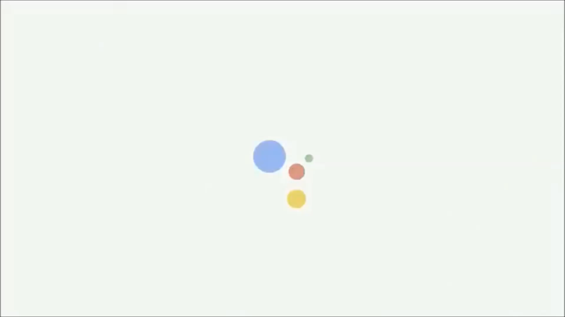
Conversational agents Passing Turing’s test

Slide 30
Generating human language

Slide 31
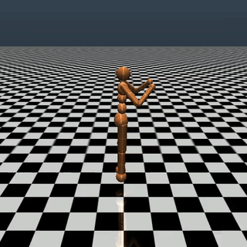
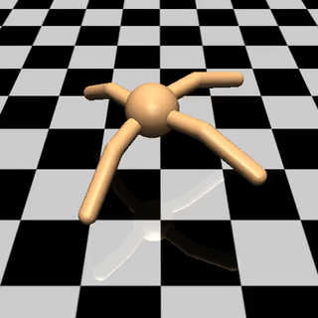
Motor output learning

Slide 32
Note about today’s practical
Generative models are at the cutting edge of machine intelligence research
Today’s practical notebooks are very advanced but very cool
Don’t worry too much about the details of the code snippets
For this class purposes, you are not responsible for them
Focus instead on the general overview of the field

Slide 33
Practical
1 text-generation-with-lstm (relevant)
2 neural-style-transfer (relevant)
3 generating-images-with-vaes (optional)
4 Jazz improvisation with LSTM (optional)

Slide 34
Talk to a GPT-2 transformer: https://talktotransformer.com
Chatbot: https://convai.huggingface.co

